Slide 1

Introduction to Smarker
The world’s smartest marker!
Harshavardhan Srinivas
Ting-yu (Steven) Yeh
Instructor: Amr Elkady
Date: Mar 15th, 2019

Slide 2
Objective

Slide 3
Outline / Objective
Lightweight drawing robot

Slide 4
Outline / Objective
Lightweight drawing robot
Supports wifi control

Slide 5
Outline / Objective
Lightweight drawing robot
Supports wifi control
Requires no additional hardware support

Slide 6
Getting Started

Slide 7
System Components

Slide 8
System Components
Controller + Software (ESP32 + Arduino IDE)
Remote control

Slide 9
System Components
Controller + Software (ESP32 + Arduino IDE)
Remote control
Actuators (Stepper Motor, Servo Motor)
Movement

Slide 10
System Components
Controller + Software (ESP32 + Arduino IDE)
Remote control
Actuators (Stepper Motor, Servo Motor)
Movement
Web/Mobile app

Slide 11
System Components
Controller + Software (ESP32 + Arduino IDE)
Remote control
Actuators (Stepper Motor, Servo Motor)
Movement
Web/Mobile app
Cloud API

Slide 12
Building the Rest

Slide 13
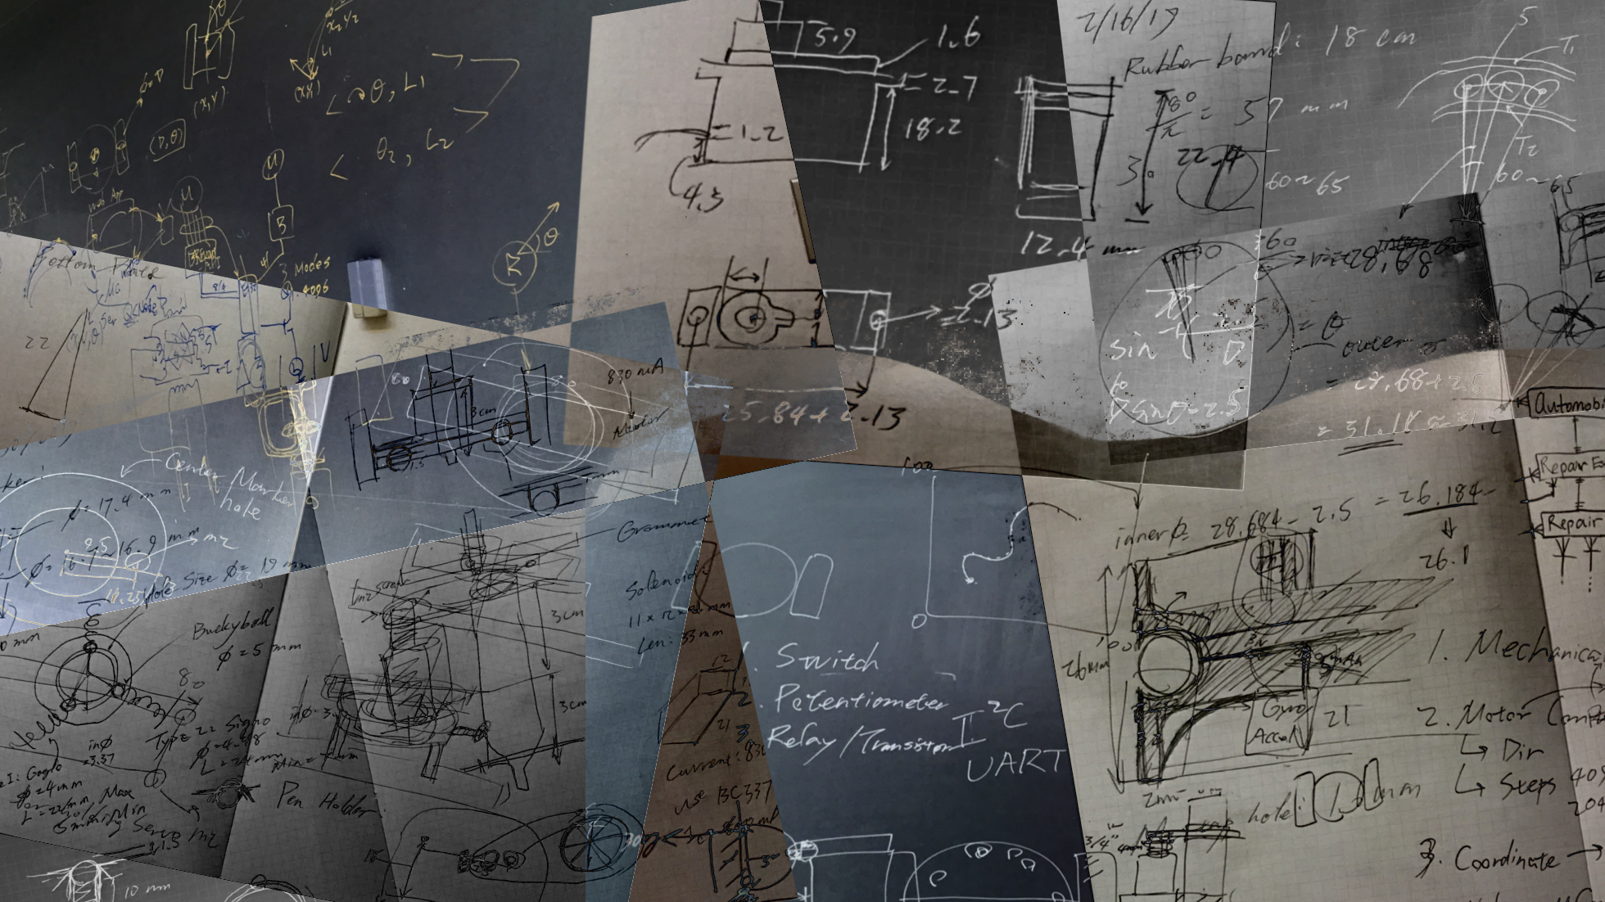
Concept Design

Slide 14
How did we build the rest?
3D Printing!

Slide 15
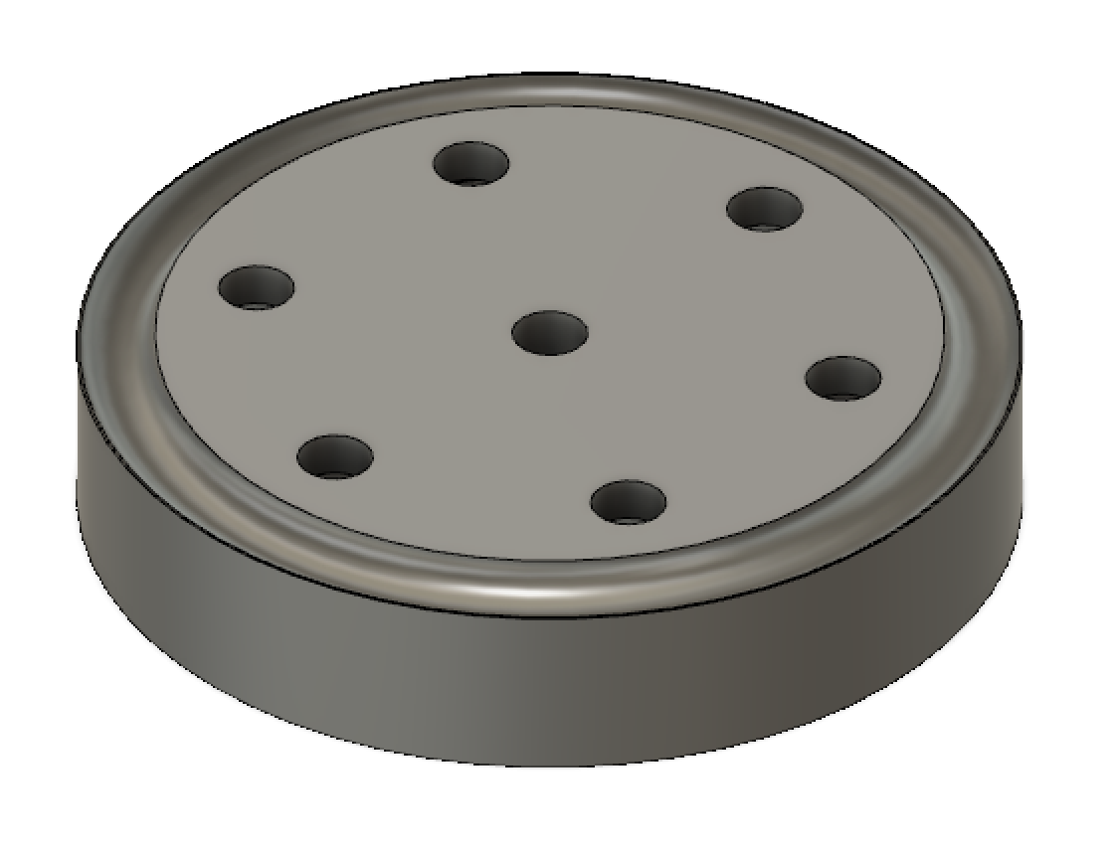
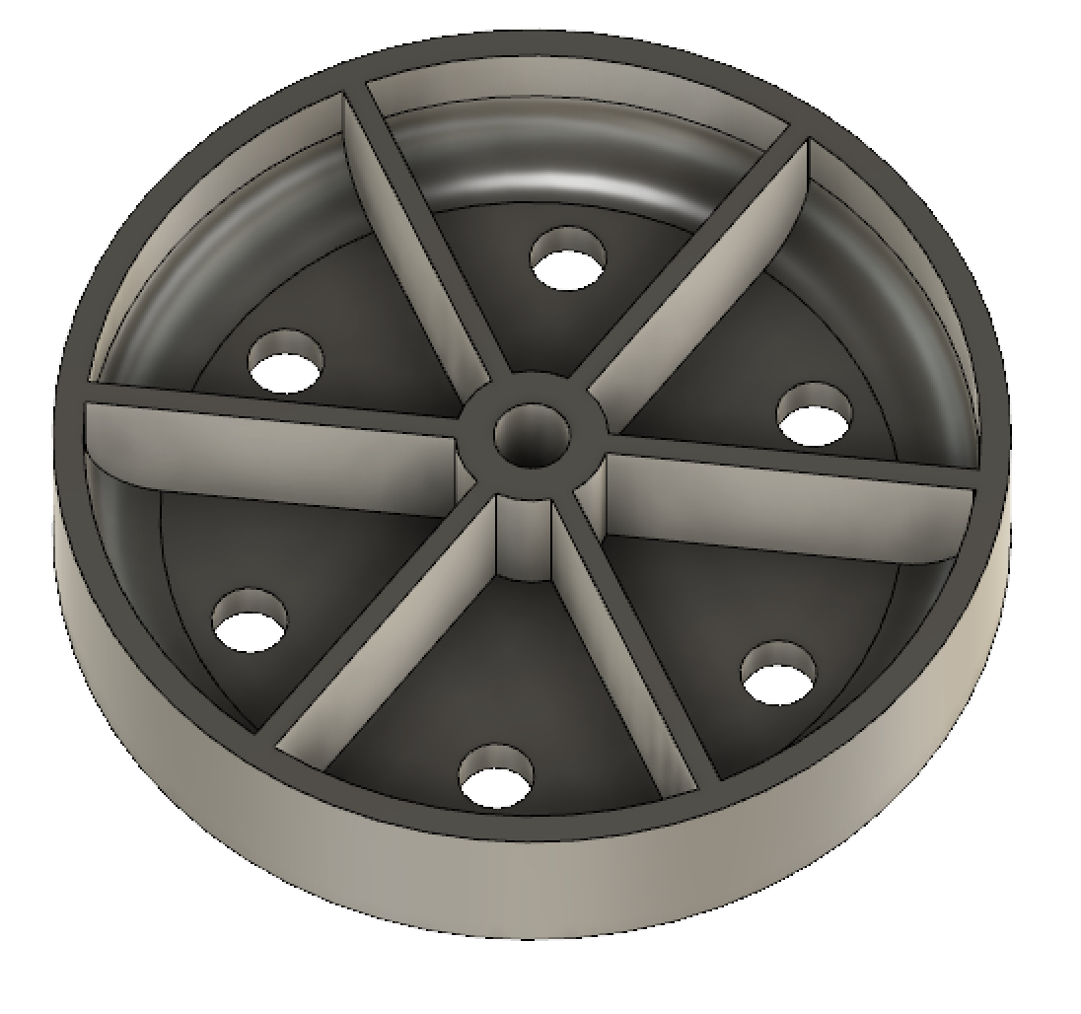
How did we build the rest?
3D Printing!

Slide 16
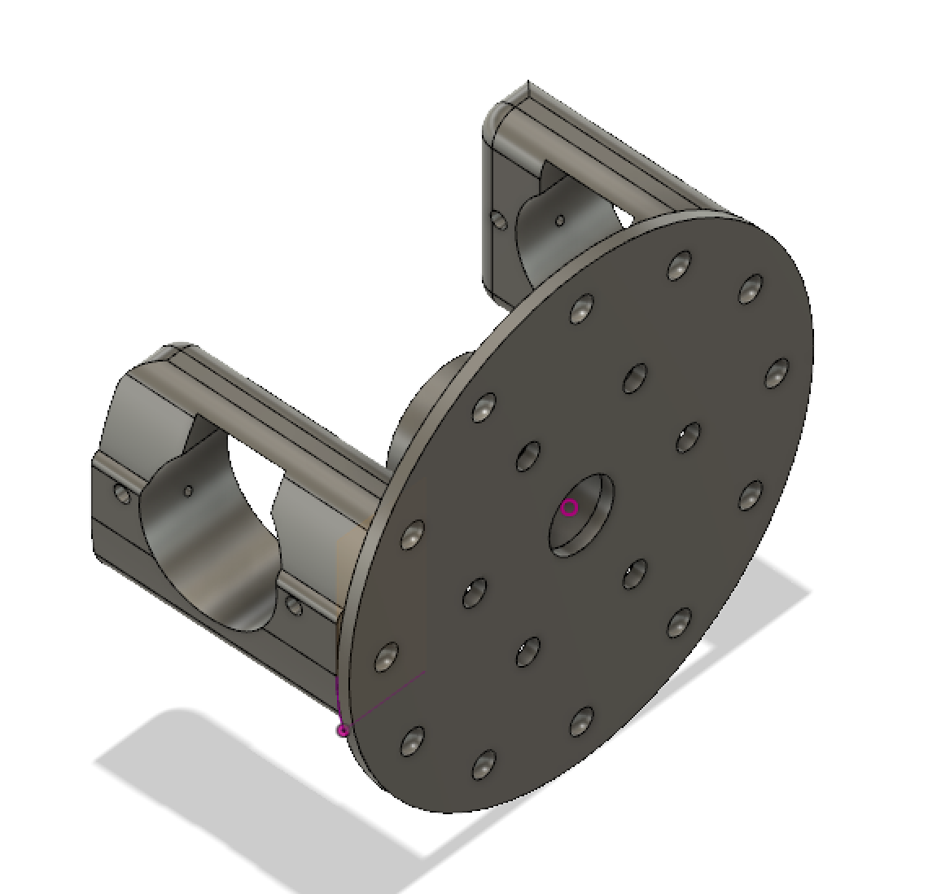
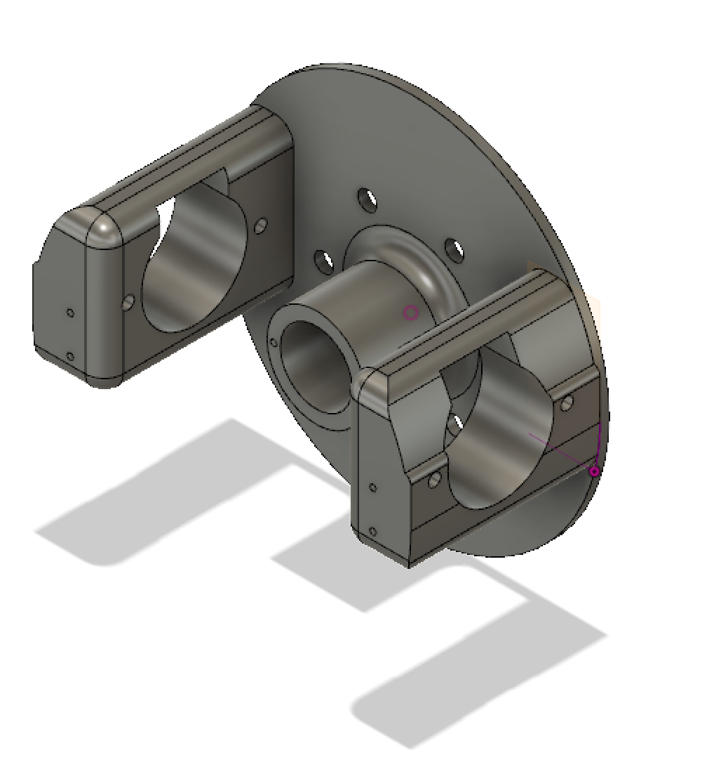
How did we build the rest?
3D Printing!

Slide 17
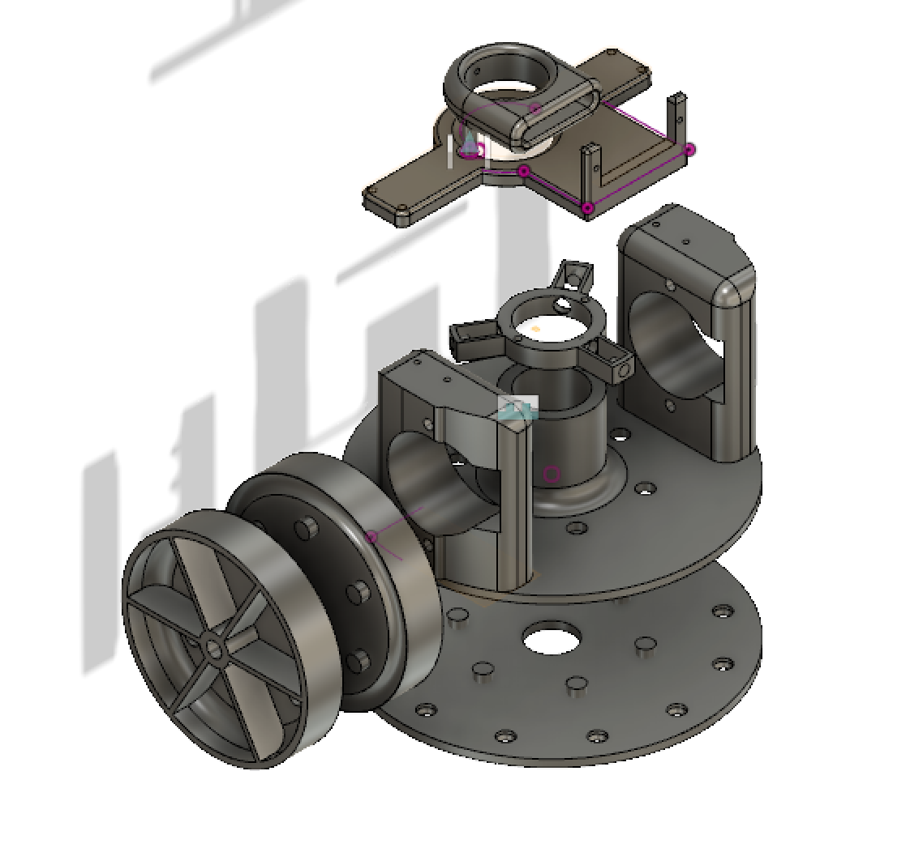
How did we build the rest?
3D Printing!

Slide 18
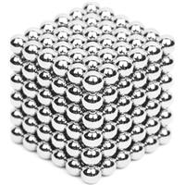
How did we build the rest?
Buckyballs!
Weighs only 1g, can pull 200g

Slide 19
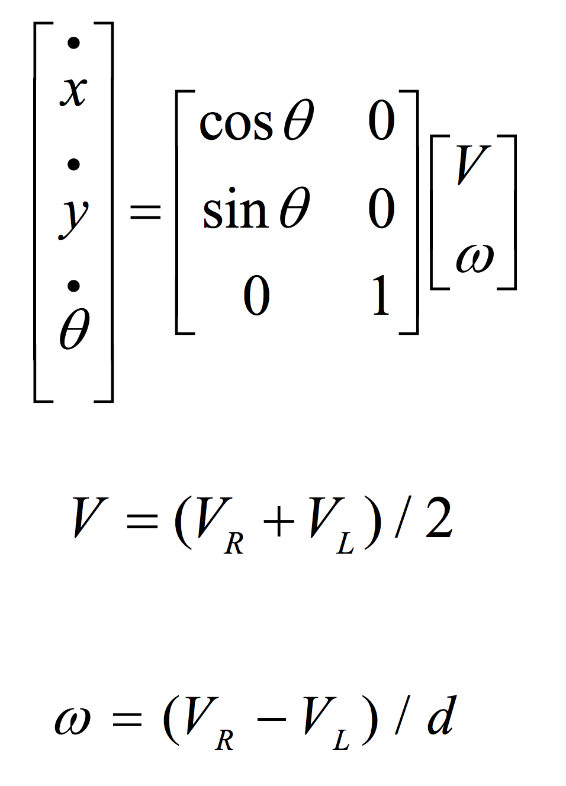
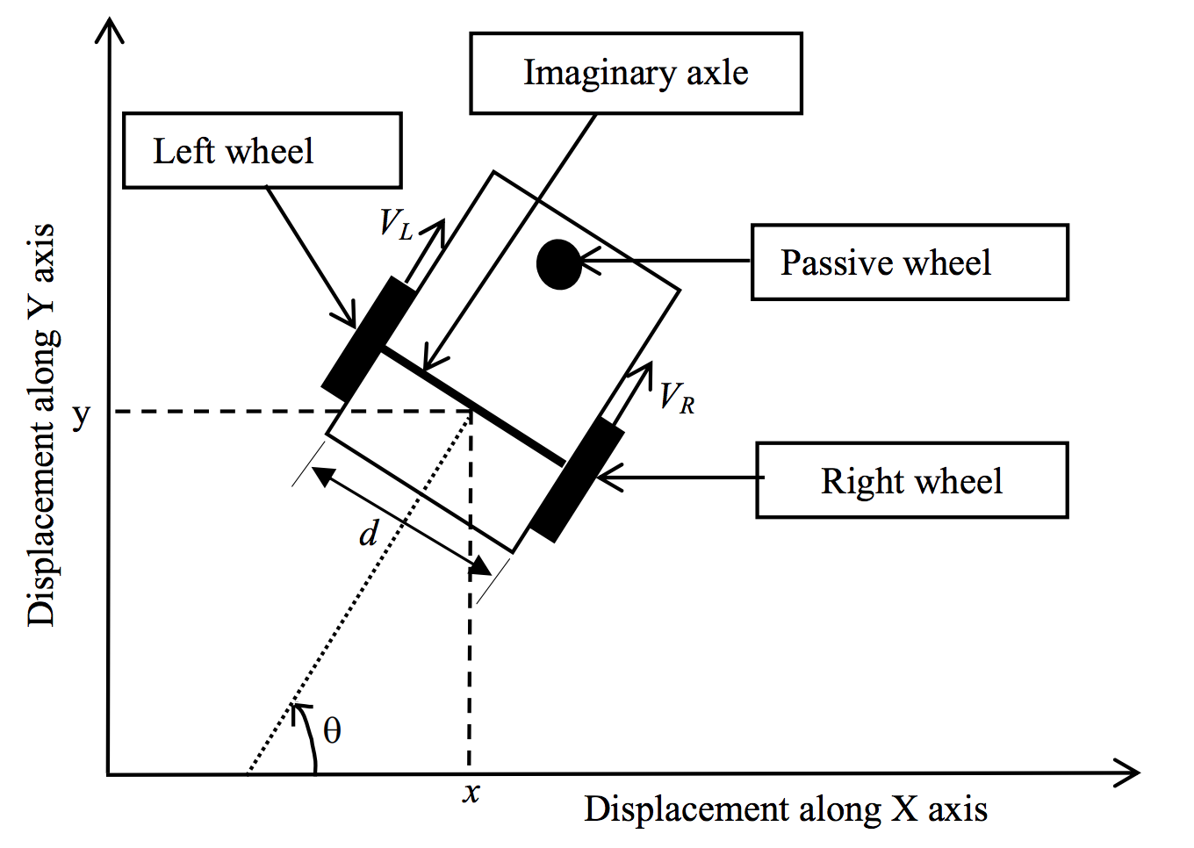
Theory for Mobile Robotics
Notes:
1:15
SMarker is categorized as a non holonomic robot
holonomic is just a big term which means your current state depends on how you reach to this state
THe most common example is parallel parking.
If your car is a holonomic system, your car will be able to move sideway into the slots
unfortunately most of our cars are also holonomically constrained, so we have to move back and forth, slowly squiggle into the tiny spots.
same thing goes to our smarker system
we want x and y move ment, but the only thing we can control is the rotation of the two wheels.
This is also a major path planning challenges that numerous researches are working on

Slide 20
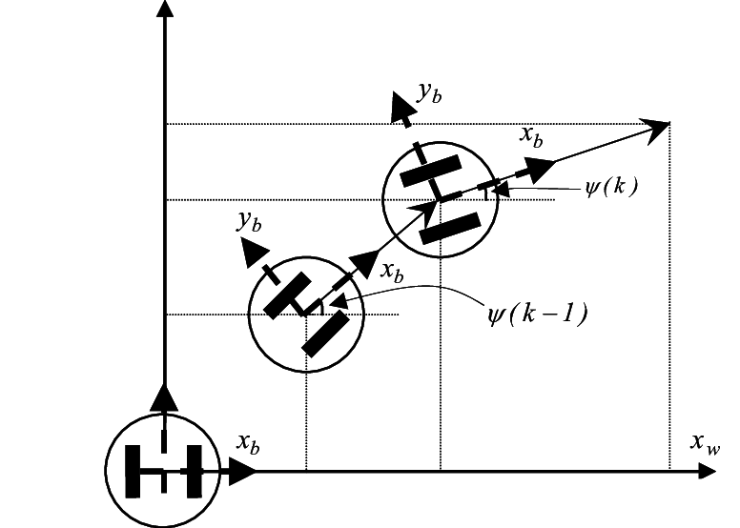
How do we control the bot?
Keeping track of coordinates!

Slide 21
How do we control the bot?
Keeping track of coordinates!
Assume no-slip condition
Notes:
stepper motors are controlled by pulses.
for each segment of the path, we send a control command and ask each wheel to turn certain degrees
We keep track of the odometry on each wheel and assume there is no slippage

Slide 22
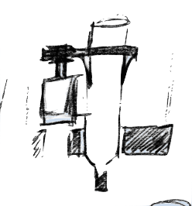
How do we control the marker?
Servo moves it up/down
Notes:
We use a metal geared servo motor to control the up down of the marker.
Applying constant force on the marker against the wall is also a challenge
Too hard, you will push the robot off the wall
Too lightly, it will not right

Slide 23
How do we control the marker?
Servo moves it up/down
Can be controlled from web
Notes:
1:30

Slide 24
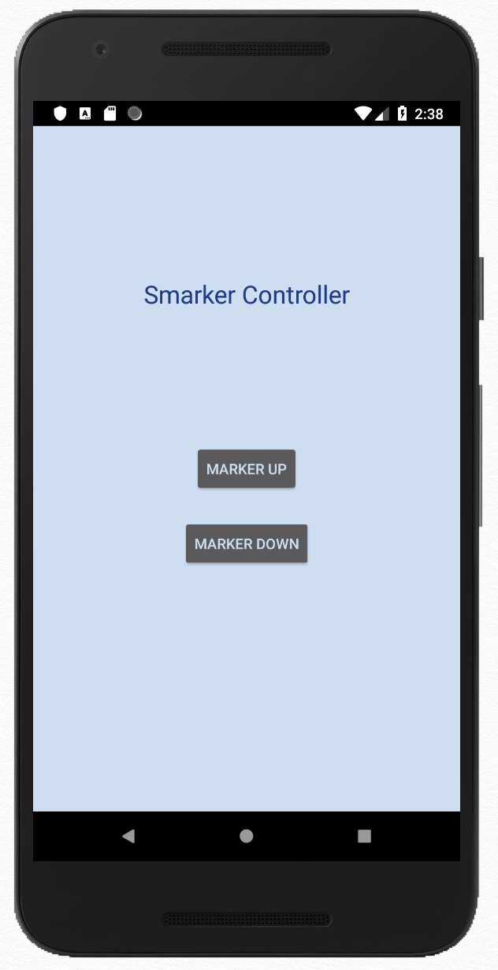
Web App & Mobile App
UI for marker control
Toggle marker up and down

Slide 25
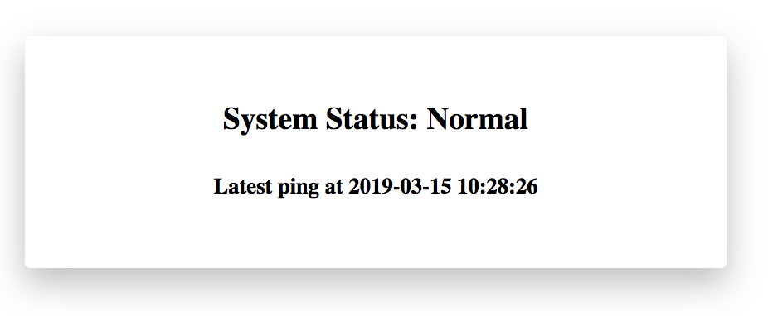
Cloud API
Realtime comprehensive monitoring

Slide 26
Bill of Materials
Part Name | Description | Quantity | Price
PLA | Prusa PLA | 170 g | Free (Maker Lab)
Stepper Motor | 28BYJ-48-5V | 2 | $4.95 (Adafruit)
Breakout Board | ULN2003 | 2 | $1.95 (ebay)
Servo Motor | MG90S | 1 | $9.95 (Adafruit)
Rubber Bands | #84 | 1 pack (45 ct) | $4.50 (Staples)
Bucky Balls | 5 mm | 1 pack (125 ct) | $19.68 (Online)
Notes:
PLA - Economical - Good for prototyping
Stepper Motor - Movement of wheels
Breakout board - Helps ESP32 drive the motor
Servo - Movement of marker up/down
Rubber bands - High friction coefficient - Ensures no slippage - Tyres
Bucky balls - Magnetic

Slide 27
Challenges
Our batteries need to support current > 1300 mA, 500 mA for each stepper motor and 300 mA for servo
Path planning of non-holonomic system
Position error
Stepper motor torque
Notes:
1:30
Closed loop control -> currently done by odometry, encoder or continuous servo drive
gravity compensation -> accelerometer +
lack of torque -> Gear ratio, voltage, tread

Slide 28
Reference
Root Robotics: https://rootrobotics.com/
Robins Mathewa, Somashekhar S Hiremath: Trajectory tracking and control of differential drive robot for predefined regular geometrical path. Procedia Technology 25 ( 2016 ) 1273 – 1280

Slide 29
Promotion Video

Slide 30
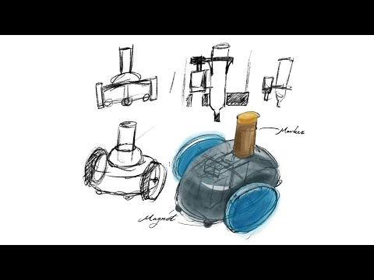

Slide 31
Q & A

